Slide 1
Unix
Introduction

Slide 2

Module Objectives
After completing this module you will be able to:
Explain what an Operating System is
List the major components of Unix
Log in and Log out of a Unix system
Be able to configure the connection settings
Describe the general format of Unix commands
Use the Unix help facility

Slide 3
Operating Systems
What is an Operating System (OS)?
A program (or group of programs) to run other programs on a computer
Responsible for managing software and hardware resources
Manages memory and CPU allocation
Manages I/O operations
Manages files
Controls computer peripherals

Slide 4
Operating Systems
Characteristics of an Operating System
Multiuser
Allows multiple users to share and use the computer relatively independently, that is not see each other’s files.
Multiprocessing / Multitasking
Allows multiple applications to run at the 'same time', even with just one CPU.
The CPU switches so rapidly between processes it looks like they are all running simultaneously.
Multithreading
Allows a program to run on more than one CPU core at a time
Realtime
Ability to process and respond to input instantly. Almost impossible without specialised hardware.

Slide 5





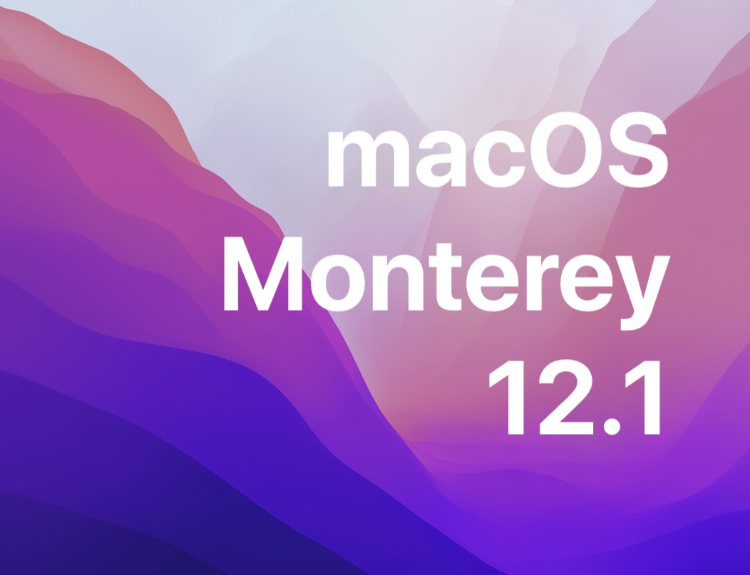

Versions of Unix
The FDM server is currently running Linux 5.4.0-1067-azure x86_64

Slide 6
Unix Architecture
Programs
Shell
Kernel
Hardware
Notes:
The inner most layer is the hardware, the kernel sits above the hardware and manages all hardware devices and controls programs which run on the computer
The kernel is loaded into memory at boot-up time and manages processes, the filesystem, memory. Essentially the kernel is the operating system.
The Shell is an interface program between the user and the kernel and is loaded into memory when the user logs on.
User will run programs from the shell.
User programs and utility programs interact with the kernel via system calls.

Slide 7
User Interfaces
Graphical User Interface (GUI)
Command Line Interface
Unlike Microsoft Windows, which has a standard look and feel, there are many different GUIs available for Unix. Some of the more popular ones include:
KDE
Gnome
LXDE
XFCE
OpenBox
CDE
Java Desktop
There are 3 prominent and supported shells on most Unix systems:
C shell (csh)
Bourne shell (sh)
Korn shell (ksh)
The Bourne Again shell (bash), the Linux default, is an enhanced Bourne shell.
We will be using the bash shell on this course

Slide 8
Files and Processes
Files
Processes
Regular files
Directories
Symbolic links
FIFO (named pipes)
Block special
Character special
Sockets
User processes
Daemons
Kernel processes
Notes:
Files:
Regular: User documents, scripts, commands etc.
Directory: Index used for organizing files on disk
Symbolic Link: a reference to another file
FIFO: allow unidirectional communication between processes
Device files apply access rights to devices and direct operations on the files to the appropriate device drivers.
Block special: communicates with devices that are randomly accessible (e.g. external hard drive)
Character special: communicates with devices that provide only a serial stream of input or accept a serial stream of output (e.g. a keyboard)
Socket: allow duplex (two-way) communication between processes
Processes:
User process: initiated by a regular user account and runs in user space.
Daemon: designed to run in the background, typically managing some kind of ongoing service. Although daemon processes are typically managed as services by the root user, they often run as non-root users by a user account that is dedicated to the service. Systems often start daemons at boot time and have them run continuously until the system is shut down.
Kernel: execute only in kernel space. They are similar to daemon processes, except that kernel processes have full access to kernel data structures, which makes them more powerful than daemon processes that run in user space.

Slide 9
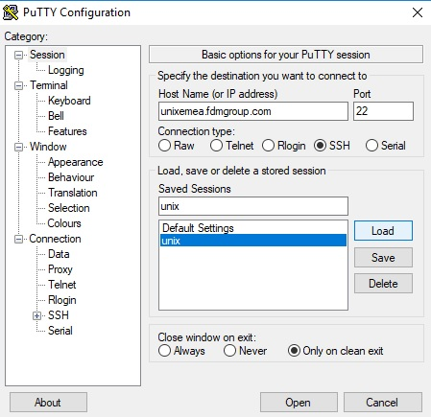
Logging in - Windows (using Putty)
If this is the first time connecting to the server, a security warning will appear. This is normal. Just click 'Yes'.
NB: when you type your password, the cursor will not move, although it will be recording your keystrokes.
Notes:
Unix is a multi-user and multitasking system which means many users can access the system at the same time through different terminals and users can work on one task while another is being performed.
To connect to the FDM Unix server, you need an SSH (Secure Shell) client such as PuTTY. Enter 'unixemea.fdmgroup.com' as the hostname and then enter your username and password when prompted.
PLEASE NOTE! When you type your password the characters will not be displayed
If this is a first time connection from that machine a security prompt will appear warning that the servers hosts key is not stored in the registry, on this occasion do not worry about this it is normal. Although with all security alerts you need to be certain any potential security breach.
You should save these settings to ensure they are always available.
Hitting yes will cache the key in the registry and you will not see this warning again on that particular machine.

Slide 10
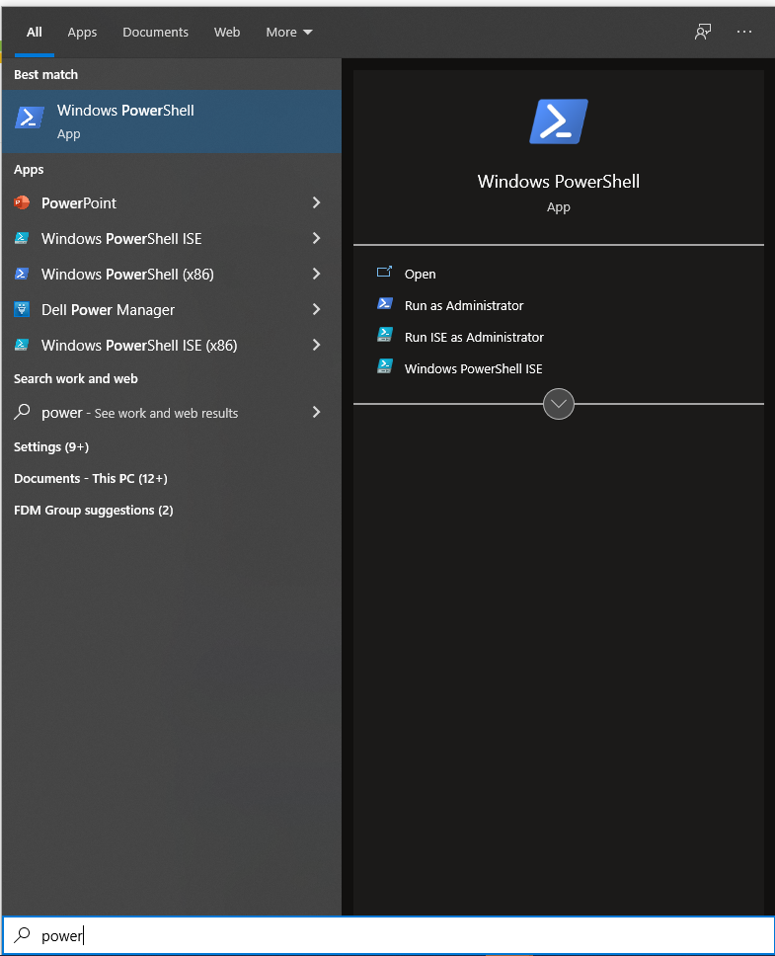
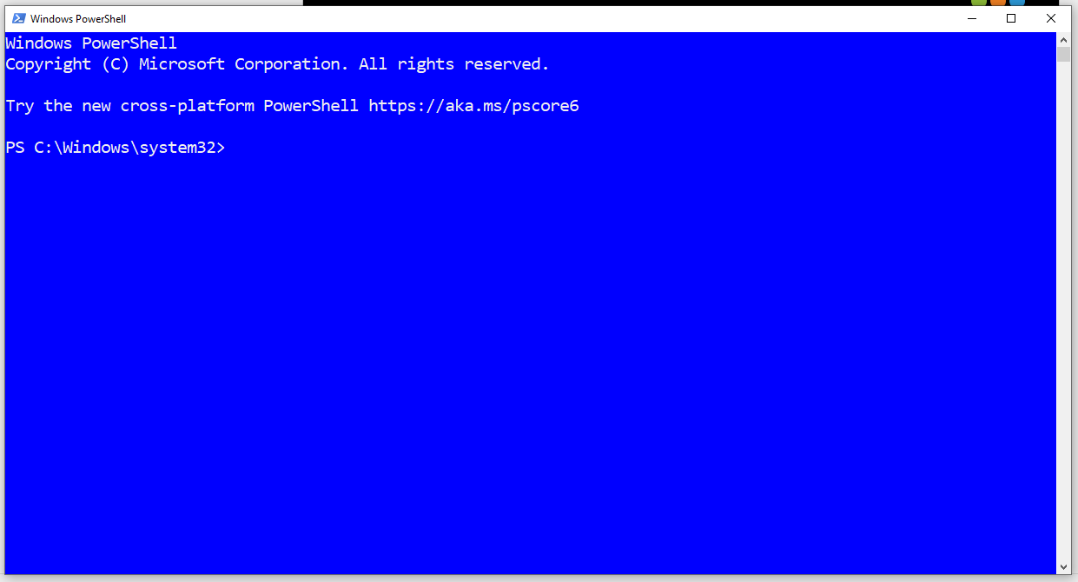
Logging in - Windows (using PowerShell)
Typing 'power' in the search bar (below left), reveals the Windows PowerShell app.
Launching Windows PowerShell gives an interactive command line tool, much like the bash shell we are about to use.

Slide 11
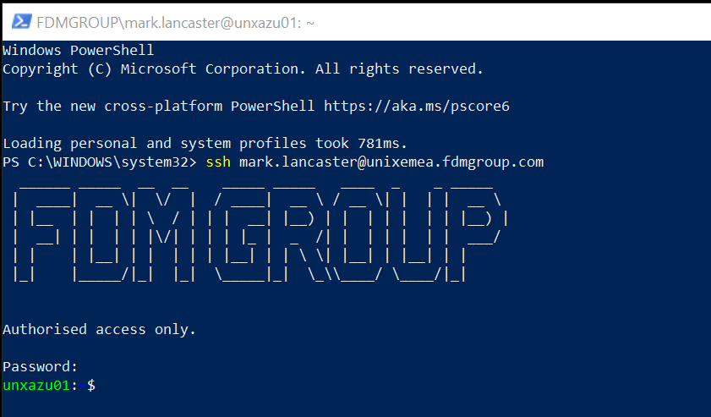
Logging in - Windows (using PowerShell)
At the PowerShell prompt, enter:
ssh your.username@unixemea.fdmgroup.com and press Enter
If this is the first time connecting to the server a security warning will appear. Click 'Yes' to continue.
Enter your password. As with putty, the cursor will not move as you type.

Slide 12
Logging in - Mac OS
Open the 'Terminal' application on your Mac. This is usually located under :
Applications → Utility → Terminal
(This should open up a blank terminal with a prompt for your input.)
Type the following command into the terminal :
ssh your.username@unixemea.fdmgroup.com
At the prompt, enter your password. As with Putty and PowerShell, the cursor will not move as you type.
Upon connecting for the first time, you may encounter a message similar to the following :
The authenticity of host 'unixemea.fdmgroup.com (51.104.208.78)' can't be established.
ECDSA key fingerprint is 98:ee:6a:fc:d7:8b:ba:3c:bd:43:0e:29:5c:93:2f:ea.
Are you sure you want to continue connecting (yes/no)?
Enter yes to continue. You may then receive a message such as this one :
Warning: Permanently added 'unixemea.fdmgroup.com,51.104.208.78' (ECDSA) to the list of known hosts.

Slide 13
Unix Command Format
Most Unix commands have the following structure:
command -option(s) argument(s)
ps
ps -f
ps -u username
Command
Option
Argument
Options are sometime called flags or switches. They switch a specific command behaviour on or off.

Slide 14
Linux Option Format
Linux introduced a user-friendly way of setting options.
Instead of using a single letter, they allow you to use a word.
Using '--' lets the system know you are choosing the word format, rather than the letter format.
ls –i filename
ls --inode filename
NB: Unix commands, options and arguments are case sensitive.

Slide 15
The history Command
The history command keeps a list of all the other commands that have been run from that terminal session, then allows you to replay or reuse those commands instead of retyping them.
history
1019 ls ~/bin
1020 cat /etc/passwd
1021 grep -w hall /student_files/day1/grepFile
1022 history
To rerun the command on line 1019 of the history list, execute the following command:
!1019

Slide 16
The clear Command
If your terminal window is getting cluttered with lines of output, you can clear the screen with the clear command.
clear moves the screen one page down, giving the illusion of a clean screen.
You can still access the command output history by scrolling up.
You can also execute the clear command with the keyboard shortcut Ctrl+L

Slide 17
Getting help - man
The online manual (man) provides help for all standard commands.
man ps
man passwd
man -s 5 passwd
The manual is broken down into sections:
Section 1 : User commands (executable programs or shell commands)
Section 2 : System calls (functions provided by the kernel)
Section 3 : Library calls (functions within program libraries)
Section 4 : Special files (usually found in /dev)
Section 5 : File formats and conventions eg /etc/passwd
Section 6 : Games
Section 7 : Miscellaneous (including macro packages and conventions),
Section 8 : System administration commands (usually only for root)
Section 9 : Kernel routines [Non standard]

Slide 18
Getting help - whatis
If you only want to see what a command does, and not display the contents of the manual, use the whatis command.
This displays just the short description of the command from the manual page:
whatis ps
ps (1) - report a snapshot of the current processes.

Slide 19
Getting help - apropos
If you do not know the name of a command, you can search within the descriptions in the manual pages by using the apropos command:
apropos snapshot
btrfs-send (8) - generate a stream of changes between two subvolume snapshots
lxc.snapshot (1) - Create container snapshots
lxc.delete (1) - Delete containers and snapshots
lxc.rename (1) - Rename containers and snapshots
lxc.restore (1) - Restore containers from snapshots
ps (1) - report a snapshot of the current processes.

Slide 20
Module Objectives
After completing this module you should be able to:
Explain what an Operating System is
List the major components of Unix
Log in and Log out of a Unix system
Be able to configure the connection settings
Describe the general format of Unix commands
Use the Unix help facility

Slide 21
Questions

